Slide 1
Relational Database Design
For developers
Quick Intro Course

Slide 2
Agenda
What is a Relational Model
Relationships
Modification anomalies
Database Normalization Forms
Constraints

Slide 3
The Relational Model
All data are represented as tables (relations)
Tables are comprised of rows and columns
A row is also called a record (or tuple).
A column is also called a field (or attribute).
Rows are (officially) unordered (the order in which rows are referenced does not matter)
Each table has a primary key, a unique identifier constructed from one or more columns
A table is linked to another by including the other table's primary key. Such an included column is called a foreign key

Slide 4
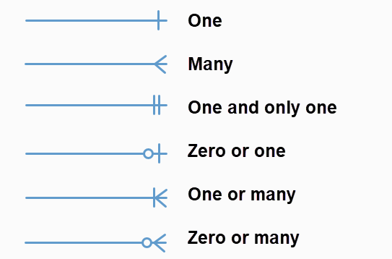
Relationships
One-to-one
One-to-many
Many-to-many
Self referencing

Slide 5
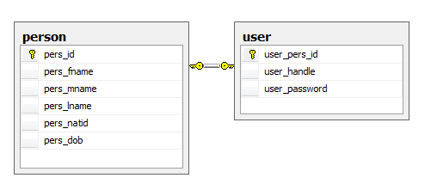
One to one - do we need them?
Chunk of optional attributes
Performance denormalization

Slide 6
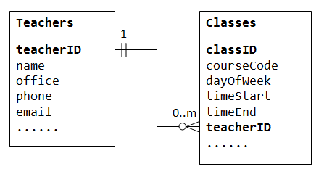
One to Many

Slide 7
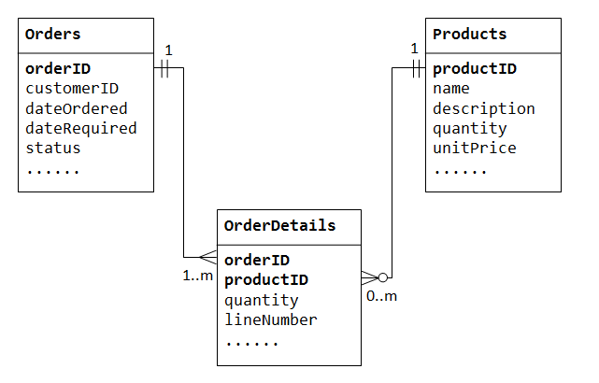
Many to Many

Slide 8
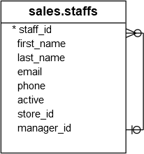
Self referencing

Slide 9
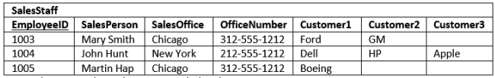
Reasons for Normalization
Data duplication
Modification anomalies (Insert, Update and Delete)

Slide 10
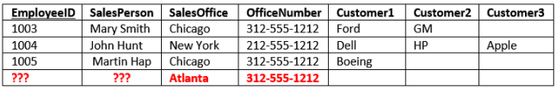
Insert Anomaly
Cannot record a new sales office until we also know the sales person

Slide 11

Update Anomaly
The same information is recorded in multiple rows.
If the value changes, then there are multiple updates that need to be made.

Slide 12

Delete Anomaly
Deletion of a row can cause more than one set of facts to be removed

Slide 13
Search and Sort Issues
SELECT SalesOffice FROM SalesStaff WHERE Customer1 = ‘Ford’ OR Customer2 = ‘Ford’ OR Customer3 = ‘Ford’

Slide 14
Normalization Forms
First Normal Form (1NF)
Second Normal Form (2NF)
Third Normal Form (3NF)
Boyce-codd normal form (BCNF)
Fourth Normal Form (4NF)

Slide 15
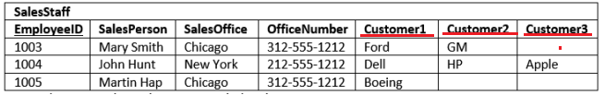
1NF – First Normal Form Definition
Each column contains atomic values and there are not repeating groups of columns.

Slide 16
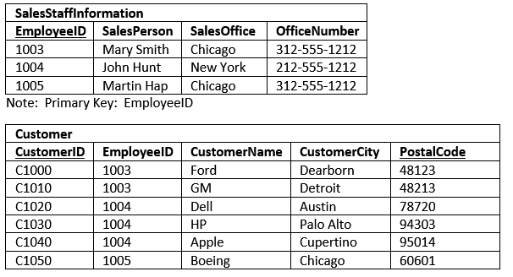
1NF – fixed design

Slide 17
New design benefits
The original design limited each SalesStaffInformation entry to three customers. In the new design, the number of customers associated to each design is practically unlimited.
It was nearly impossible to Sort the original data by Customer. You could, if you used the UNION statement, but it would be cumbersome. Now, it is simple to sort customers.
The same holds true for filtering on the customer table. It is much easier to filter on one customer name related column than three.
The insert and deletion anomalies for Customer have been eliminated. You can delete all the customer for a SalesPerson without having to delete the entire SalesStaffInformaiton row.

Slide 18
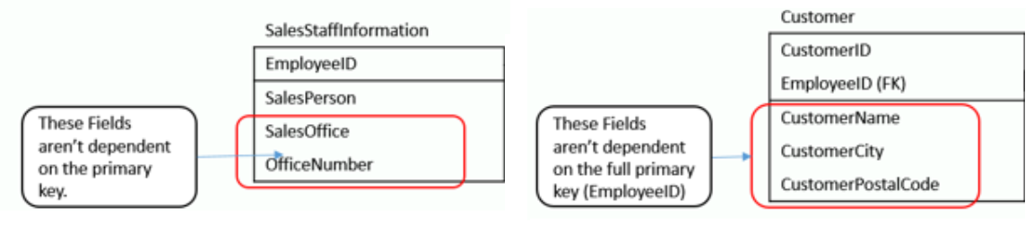
2NF – Second Normal Form Definition
The table is in 1st normal form, and
All the non-key columns are dependent on the table’s primary key.

Slide 19
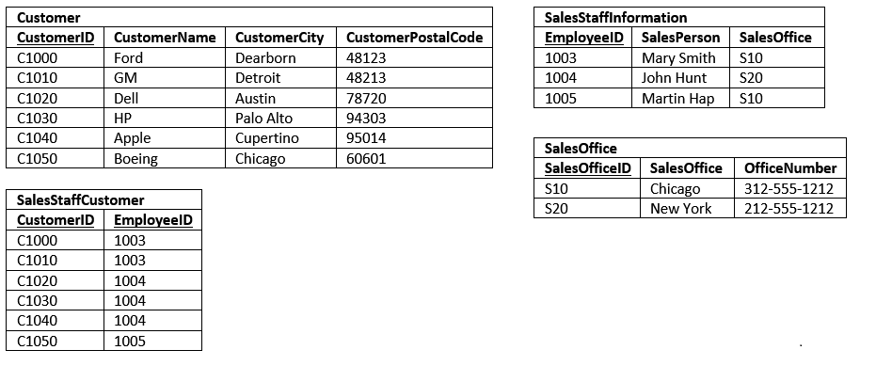
2NF - Fixed Design

Slide 20
3NF – Third Normal Form Definition
A table is in 2nd normal form.
It doesn’t have transitive dependency
Customer
CustomerID
CustomerName CustomerCity CustomerPostalCode
The CustomerCity
depends on CustomerPostalCode

Slide 21
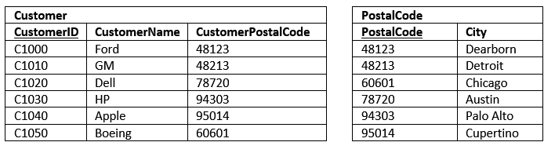
3NF - Fixed design

Slide 22
Relational Database Model Constraints
Domain constraints
Key or uniqueness constraints
Referential integrity constraints

Slide 23
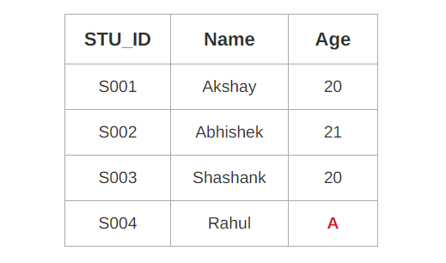
Domain Constraint
Domain constraint defines the domain or set of values for an attribute.
It specifies that the value taken by the attribute must be the atomic value from its domain.

Slide 24
Key or uniqueness constraint
Each table should have a column (or a set of columns), called primary key
The primary key shall always have a value. In other words, it shall not contain NULL.
The value of the primary key should not change.
It is best to use numeric column as primary key for efficiency.
Things to consider
Single Column vs Multi-Column PK
Unique meaningful value vs random generated
Auto-Increment Integer vs UUID

Slide 25
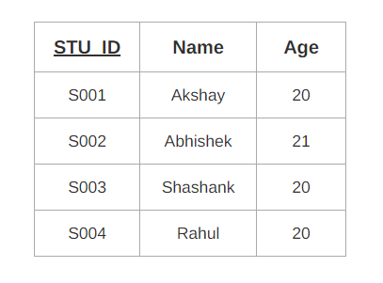
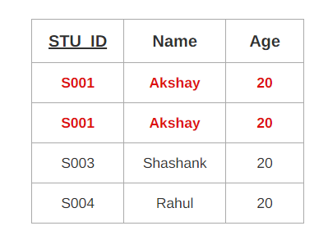
Key or uniqueness constraint - example

Slide 26
Referential integrity - Foreign Keys
FK columns can be NULL
FK doesn’t automatically create Index
Referential Integrity
No Action/Restrict
Cascade
Set Null
Set Default

Slide 27
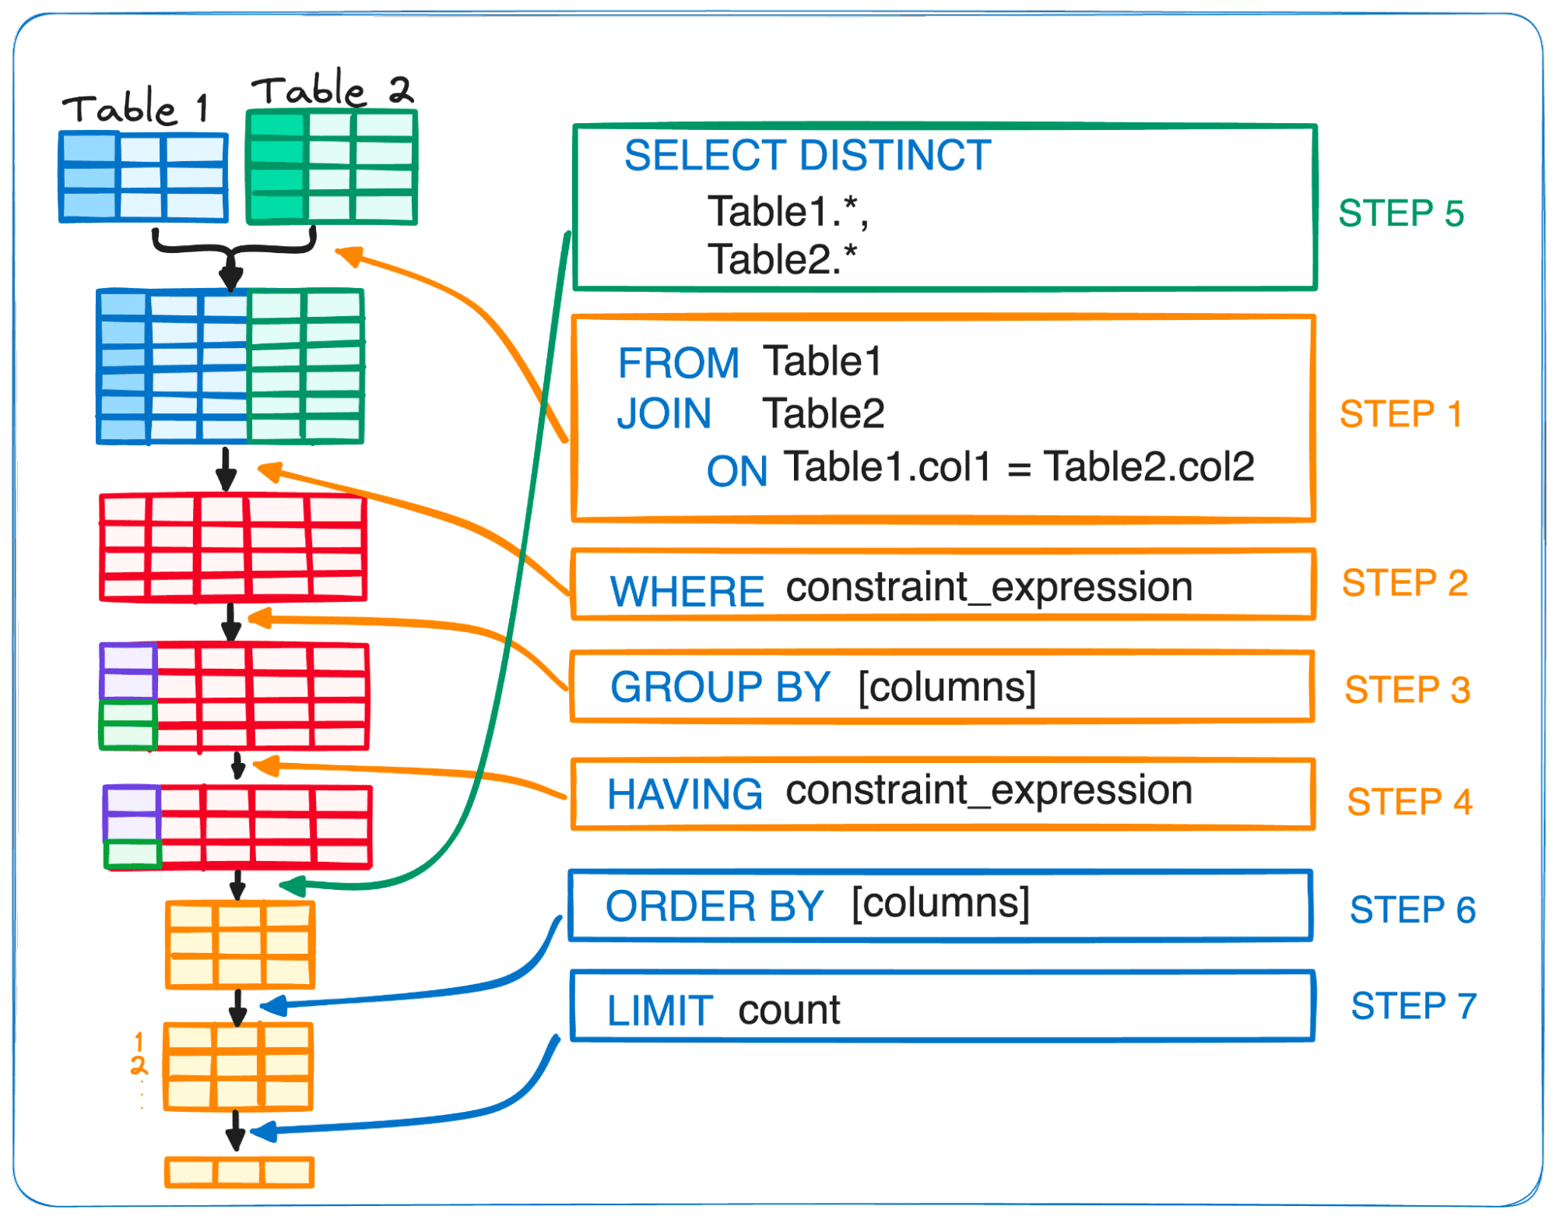
SQL commands and order of execution

Slide 28
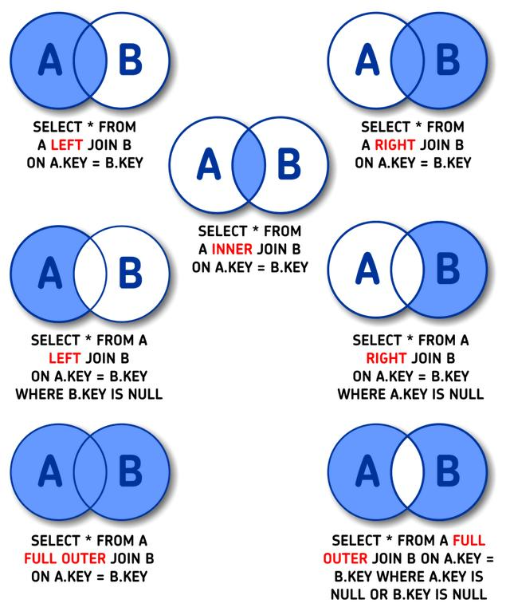
SQL joins

Slide 29
Some useful links
PosgresSQL Course

